Slide 1
IMPACT OF EV PENETRATION IN ELECTRIC GRID
Guided by
Dr. Bobby Phillip
Assistant Professor
Presented by
Mohammed Ehsan 145
Anna Joseph 822
Anand Vs 123

Slide 2
Introduction
The increasing penetration of electric vehicles (EVs) in the global market has significant implications for the electric grid. As more EVs are adopted and charged, there is an increased demand for electricity that the grid must accommodate. This increased demand can cause strain on the grid, particularly during peak charging times when many people are charging their vehicles at the same time.
One of the main challenges in accommodating this increased demand is ensuring that the grid has enough capacity to handle it. This may require upgrades to existing infrastructure, such as adding new power plants and transmission lines, as well as upgrading distribution networks to handle the increased demand.
Another challenge is ensuring that the electricity used to charge EVs is generated from clean, renewable sources. This requires a shift away from fossil fuels and towards renewable energy sources, such as wind and solar, to meet the increased demand for electricity.

Slide 3
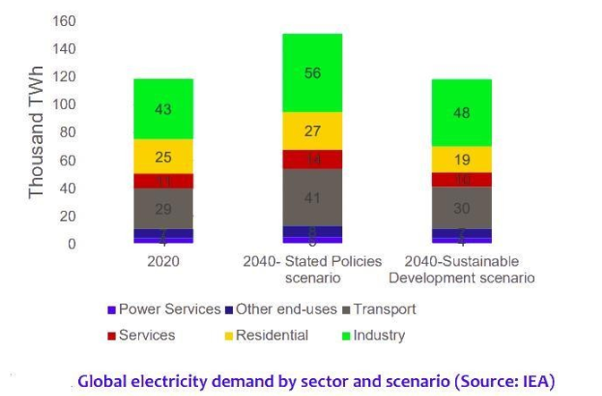
To mitigate these challenges, grid operators and energy companies are exploring solutions such as demand response programs, time-of-use pricing, and smart charging technology. Demand response programs incentivize EV owners to charge their vehicles during off-peak times, helping to balance the demand for electricity on the grid. Time-of-use pricing adjusts electricity prices based on the time of day and the level of demand, encouraging consumers to shift their charging habits to off-peak times. Smart charging technology allows EVs to be charged in a way that balances the demand for electricity on the grid and reduces strain on the grid during peak times.
In conclusion, the penetration of EVs in the electric grid presents both challenges and opportunities. Addressing these challenges will require a coordinated effort by government, energy companies, and consumers to ensure a sustainable and resilient electric grid that can accommodate the growing demand for clean and renewable energy.

Slide 4
HIGH EV PENETRATION LEADS TO HIGHER RE INTEGRATION
Yes, it is generally true that high electric vehicle (EV) penetration leads to higher renewable energy (RE) integration.
This is because EVs are powered by electricity, and if that electricity is generated from renewable sources like solar, wind, or hydro, it results in a lower carbon footprint compared to using fossil fuels. As the adoption of EVs increases, the demand for electricity also increases, creating an opportunity for renewable energy sources to meet that demand.
In addition, EVs can also provide a means of energy storage for intermittent renewable energy sources like solar and wind. During times of excess generation, the electricity can be stored in EV batteries, and during times of low generation, the stored electricity can be fed back into the grid to support demand.
Therefore, higher EV penetration can stimulate the development and deployment of renewable energy sources, which can lead to a more sustainable and cleaner energy system.

Slide 5
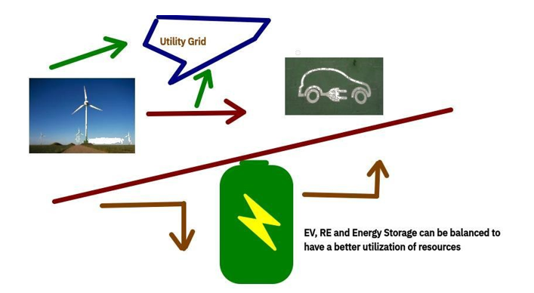

Slide 6
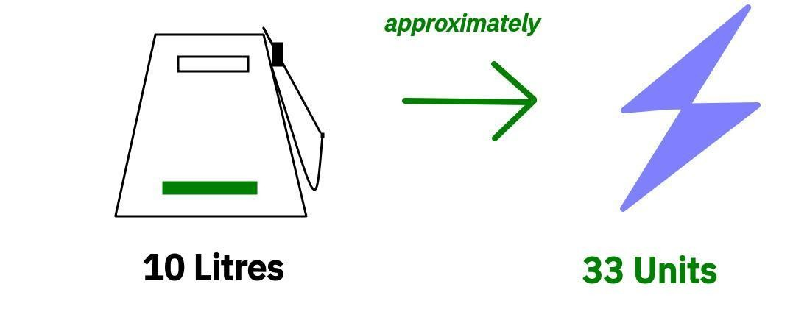
Estimated household energy requirement for transportation(4W)
Approximately 10 litres of fuel[petrol/diesel] is consumed by a common household 4W in a normal working week(sample survey)
This transpires to a transportation electricity requirement of
approximately 33 kWhs [33 units]

Slide 7
Literature Survey
J. Carlos Gómez, Medhat M. Morcos (2003)
The simple program developed in the paper investigates the effect of battery charger on the distribution transformer life expectancy; an important tool for planning purposes. The proposed tool can be easily applied to the determination of the optimum charging time as function of existing load, ambient temperature, and daytime. From the study, it can be seen that the direct connect-and-charge scheme is detrimental to the transformer life span, especially under high temperature and important penetration conditions. Calculations show the existence of a quadratic relationship between the transformer life consumption and the battery charger current THD. It is also indicated that the current THD should be limited to 25–30% in order to have a reasonable transformer life expectancy.
Carolina M. Affonso, Mladen Kezunovic (2018)
This paper analyses the effect of PEV demand on distribution transformer lifetime serving a residential complex with 8 houses. The Monte Carlo simulation method is used to consider all uncertainties related with residential and PEV demand, ambient temperature and PV generation. Summer and winter season are considered, and different aspects are analysed. The inclusion of 9 PEVs, a little bit more than one PEV per household, will considerably increase transformer aging factor, reducing its expected lifetime. When the vehicles are charging at Level 2, the inclusion of 5 PEVs in the residential area will likely deteriorate transformer life (probability of 85.4%). During the winter, transformer is not exposed to accelerated aging when charging at Level 1, regardless PEV penetration level. However, when Level 2 is adopted, even during the winter, transformer may experience aging depending on PEV penetration level. The connection of rooftop PV can avoid transformer overloading and help to prevent its life deterioration, depending on the number of PEV and operating mode.
Muratori (2018)
Electrification of transport offers opportunities to increase energy security, reduce carbon emissions, and improve local air quality. Plug-in electric vehicles (PEVs) are creating new connections between the transportation and electric sectors, and PEV charging will create opportunities and challenges in a system of growing complexity. Here, I use highly resolved models of residential power demand and PEV use to assess the impact of uncoordinated in-home PEV charging on residential power demand. While the increase in aggregate demand might be minimal even for high levels of PEV adoption, uncoordinated PEV charging could significantly change the shape of the aggregate residential demand, with impacts for electricity infrastructure, even at low adoption levels. Clustering effects in vehicle adoption at the local level might lead to high PEV concentrations even if overall adoption remains low, significantly increasing peak demand and requiring upgrades to the electricity distribution infrastructure. This effect is exacerbated when adopting higher in-home power charging.

Slide 8
Carolina M. Affonso, Mladen Kezunovic (2018)
This paper proposed an optimal charging scheme to minimize the impact of electric vehicles charging demand on a distribution transformer that serves a commercial building parking garage integrated with PV generation and BESS. The model considers time-of-use rates in order to minimize energy consumption costs and avoid transformer overloading and loss-of-life, based on load and meteorological data from Texas, USA. The investigation is performed by means of both technical and economic viability analysis, and important conclusions were obtained: Under EV uncoordinated charging scheme the transformer is subjected to overloading condition during summer season due to high ambient temperatures, exceeding its thermal limits and experiencing accelerated aging. The proposed smart charging scheme and PV-BESS system can prevent transformer overloading and loss-of-life. PV generation can reduce the energy purchased from the grid, while BESS can assist during peak hours. The PV-BESS parking garage is a feasible and profitable investment, as long as a minimum charging fee is adopted to recover the project costs. The uncoordinated charging of several plug-in electric vehicles in a parking garage can potentially overload distribution transformer reducing its lifetime. The uncoordinated charging of several plug-in electric vehicles in a parking garage can potentially overload distribution transformer reducing its lifetime. The increasing penetration of plug-in electric vehicles brings new challenges for their proper integration into the grid, especially due to uncertainties related to the behaviour of EV users.

Slide 9
Carolina M. Affonso, Mladen Kezunovic (2018)
This paper analyses the effect of PEV demand on distribution transformer lifetime serving a residential complex with 8 houses. The Monte Carlo simulation method is used to consider all uncertainties related with residential and PEV demand, ambient temperature and PV generation. Summer and winter season are considered, and different aspects are analysed. The inclusion of 9 PEVs, a little bit more than one PEV per household, will considerably increase transformer aging factor, reducing its expected lifetime. When the vehicles are charging at Level 2, the inclusion of 5 PEVs in the residential area will likely deteriorate transformer life (probability of 85.4%). During the winter, transformer is not exposed to accelerated aging when charging at Level 1, regardless PEV penetration level. However, when Level 2 is adopted, even during the winter, transformer may experience aging depending on PEV penetration level. The connection of rooftop PV can avoid transformer overloading and help to prevent its life deterioration, depending on the number of PEV and operating mode.

Slide 10
Muratori (2018)
Electrification of transport offers opportunities to increase energy security, reduce carbon emissions, and improve local air quality. Plug-in electric vehicles (PEVs) are creating new connections between the transportation and electric sectors, and PEV charging will create opportunities and challenges in a system of growing complexity. Here, I use highly resolved models of residential power demand and PEV use to assess the impact of uncoordinated in-home PEV charging on residential power demand. While the increase in aggregate demand might be minimal even for high levels of PEV adoption, uncoordinated PEV charging could significantly change the shape of the aggregate residential demand, with impacts for electricity infrastructure, even at low adoption levels. Clustering effects in vehicle adoption at the local level might lead to high PEV concentrations even if overall adoption remains low, significantly increasing peak demand and requiring upgrades to the electricity distribution infrastructure. This effect is exacerbated when adopting higher in-home power charging.

Slide 11
GAPS IN THE LITERATURE SURVEY
Limited studies have been conducted on understanding the impact of Electric grid due to Evs
Limited researches have been done

Slide 12
Objectives
To Analyze the impact created by EV in the electric Grid system
To study the limitations and challenges in the electric grid infrastructure in Kerala
Understand the ideas about reducing the impact

Slide 13
DC CHARGING
DC fast charging is a type of electric vehicle (EV) charging that provides high-speed charging using a DC power source.
It allows EVs to charge their batteries quickly, usually in 30 minutes to an hour.
DC fast charging uses a high-powered charging station, typically with a capacity of 50-350 kW.
The charging station converts the AC power from the grid to DC power that is compatible with the EV battery.
The EV's battery management system then controls the charging process.
DC fast charging is useful for EVs that need a quick charge, such as those used for long-distance travel.
However, it can be more expensive than Level 1 and Level 2 charging, and may not be suitable for daily charging as it can degrade the battery life over time.

Slide 14
IMPACTS OF DISTRIBUTION NETWORK
The distribution network refers to the network of electrical infrastructure that delivers electricity from high-voltage transmission lines to end-users, such as homes and businesses. Here are some of the impacts that the distribution network can have:
Reliability: The distribution network is responsible for delivering electricity to end-users, so it must be reliable and able to handle fluctuations in demand. A well-designed and maintained distribution network can ensure that electricity is delivered to customers with minimal interruptions.
Capacity: The capacity of the distribution network determines how much electricity can be delivered to end-users at any given time. As more people use electricity and the demand for electricity increases, the distribution network may need to be expanded or upgraded to handle the increased load.
Voltage regulation: The distribution network must maintain a stable voltage level to ensure that electrical appliances and equipment operate correctly. Voltage fluctuations can damage equipment and cause power outages.
Power quality: The quality of the electricity delivered by the distribution network can impact the performance of electrical equipment. Poor power quality can result in equipment damage or failure, as well as reduced efficiency.

Slide 15
Renewable energy integration: The integration of renewable energy sources, such as solar and wind power, into the distribution network can have an impact on the stability and reliability of the network. The intermittent nature of renewable energy sources requires careful management and coordination to ensure that the distribution network remains stable.
Smart grid technologies: The deployment of smart grid technologies, such as advanced metering infrastructure and automated distribution systems, can improve the reliability and efficiency of the distribution network. However, these technologies require significant investment and may require upgrades to the existing infrastructure.

Slide 16
CHALLENGES IN KERALA
The pace of transition to EVs (4W )will be significant when battery costs come down
Compared to other states Kerala has high household vehicle ownership hence Kerala will see comparatively bigger electricity demand in LV distribution side
Smart grid implementation, tariff fixation and smart charging involves lot of financial/law implications.
Single phase chargers pose threat to distribution system load balancing
Distribution transformers with improved K rating will mean increased cost for infra.
Safety issues are of great importance as more electrical high power equipments are connected to often less competent existing infrastructure.
Our power infrastructure was designed to carry lesser values of current. New scenario of such high currents can create hurdles at some places.

Slide 17
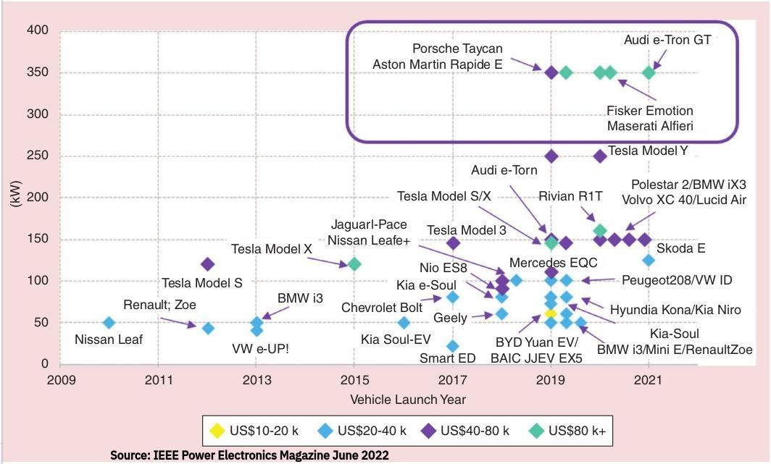

Slide 18
THANK YOU

